Slide 1

Machine Learning
Summer Internship- 2026
Name: Vishav Bharti
Supervisor: Prof. Millie Pant
Mentor: Miss Riya Applied Mathematics & Scientific Computing
Indian Institute of Technology Roorkee

Slide 2

Learning Objectives
Introduction to Machine Learning.
Data Preprocessing & EDA.
Linear & Logistic Regression.
Decision Trees & Random Forests.
SVM & K-Nearest Neighbors.
Clustering & Dimensionality Reduction.
Model Evaluation & Hyperparameter Tuning.
Feature Engineering & Pipelines.
Introduction to NLP.
Machine Learning Capstone.

Slide 3
Introduction to Machine learning
What is Machine Learning?
Machine Learning (ML) is a branch of Artificial Intelligence (AI) that enables computers to learn patterns from data and make predictions or decisions without being explicitly programmed.
Types of Machine Learning
Supervised Learning.
Unsupervised Learning.
Reinforcement Learning.
Supervised learning:
The model learns using labeled data, where the correct output is already known.
Examples
House price prediction.
Email spam classification.
Student grade prediction.
Unsupervised learning:
The model learns from unlabeled data by identifying hidden patterns.
Examples
Customer segmentation.
Market basket analysis.
Anomaly detection.
1

Slide 4
Types of ML
Reinforcement Learning
An agent learns by interacting with an environment and receiving rewards or penalties.
Components
Agent
Environment
Actions
Rewards
Supervised | Unsupervised | Reinforcement
Uses labeled data | Uses unlabeled data | Learns by rewards
Predicts outputs | Finds hidden patterns | Maximizes reward
Classification & Regression | Clustering | Decision-making
2

Slide 5
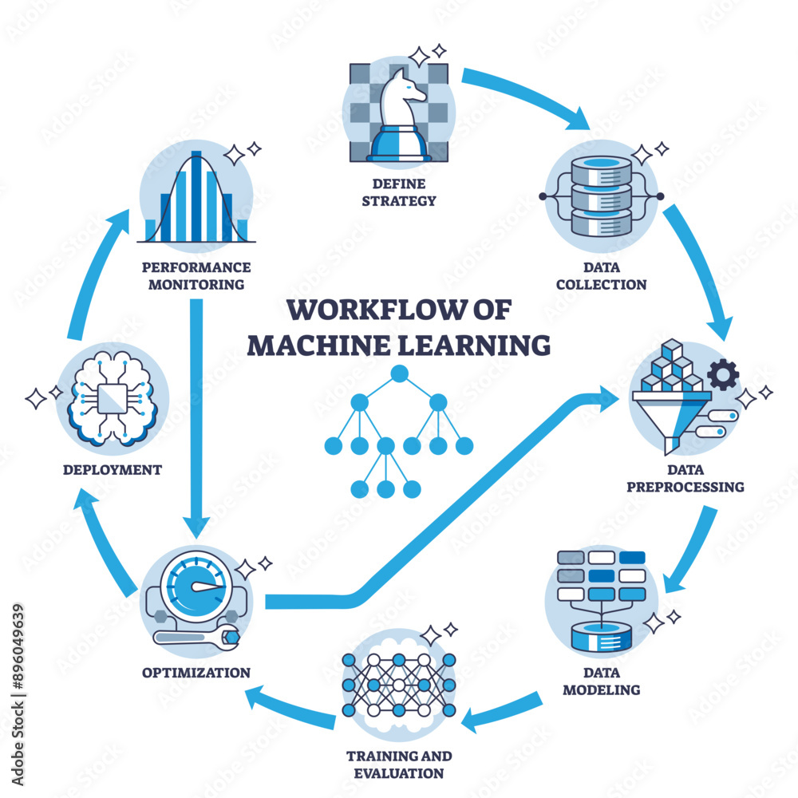
Key terminology(features,labels) & ML Workfflow
Key Terminology :
Features:
Input variables used for prediction.
Example:
Age
Salary
Height
Labels:
The target output that the model predicts.
Example:
Pass/Fail
House Price
Spam/Not Spam
Machine Learning Workflow :
Data Preprocessing – Clean and transform data.
Model Selection – Choose algorithm (e.g., decision tree, neural network).
Training – Fit the model to training data.
Evaluation – Test accuracy and performance.
Deployment – Integrate into real-world applications.
Data Collection – Gather raw data.
Monitoring – Track performance and retrain if needed
3

Slide 6
Data preprocessing & Handling Missing values
Data preprocessing:
Data preprocessing is the process of cleaning, transforming, and organizing raw data into a format suitable for machine learning models. High-quality preprocessing improves model accuracy, reduces bias, and speeds up training.
Handling Missing Values
Missing values occur due to incomplete data collection, system errors, or unavailable information. They must be handled before model training.
Methods
Fillna()- Replaces missing values with statistical measures such as mean, median, mode, or a fixed value.
Dropna()-Removes rows or columns containing missing values when they are few or not critical.
Example
-Pandas
Advantages
Improves data quality.
Prevents model errors.
Produces more reliable predictions.
4

Slide 7
Encoding categorical variables
Encoding Categorical Variables
Machine learning algorithms work with numerical data, so categorical variables must be converted into numbers.
Why it matters: ML algorithms work with numbers, not text.
Techniques:
LabelEncoder: Converts categories into integers (Assigns a unique integer to each category.). Best for ordinal data.
Example
OneHotEncoder: Creates binary columns for each category (Creates a separate binary column for each category). Best for nominal data.
Example
Gender | Encoded
Male | 1
Female | 0
Color | Red | Blue | Green
Red | 1 | 0 | 0
Blue | 0 | 1 | 0
5

Slide 8


Feature scaling
Feature Scaling
Features with different ranges can bias machine learning models. Scaling ensures equal importance.
Train-Test Split
Separates data for training and evaluation.
Common ratio:
80% Training
20% Testing
StandardScaler | MinMaxscaler
Formula: Mean = 0 Standard Deviation = 1 Used in- SVM, Logistic Regression, P | Formula: Range = 0 to 1
6

Slide 9
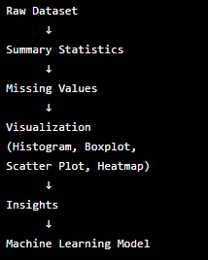
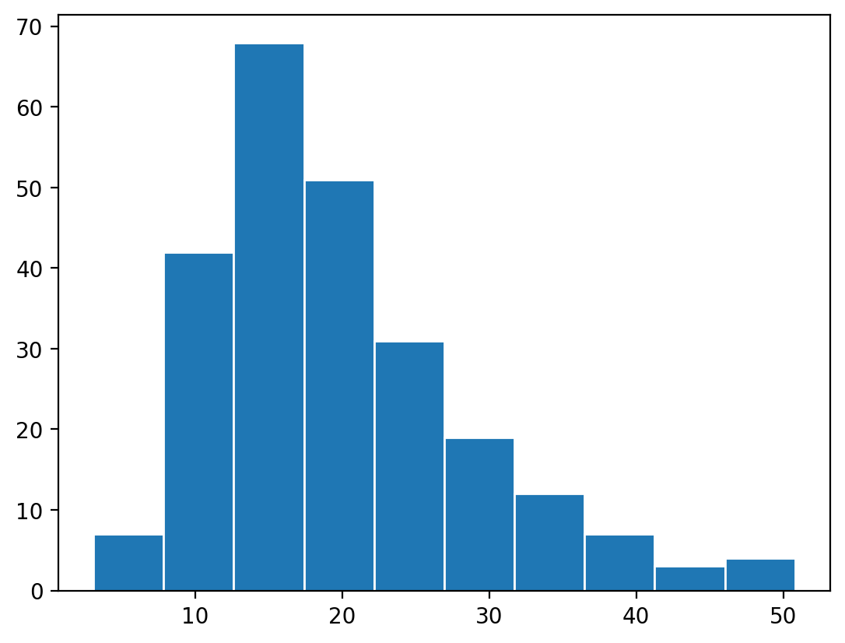
EDA
Exploratory Data Analysis (EDA)
EDA Workflow:
What is EDA?
EDA helps understand data before building a machine learning model.
Objectives
Find missing values
Detect outliers
Understand distributions
Discover relationships
Identify patterns
Purpose: Understand data distribution, relationships, and anomalies before modeling.
Tools:
Seaborn: High-level statistical plots (pairplot, heatmap, boxplot).
Matplotlib: Flexible plotting (histograms, scatter plots, line charts).
Examples:
Heatmap for correlation between features.
Pairplot to visualize relationships between variables.
Histogram to check skewness in numerical features.
7

Slide 10


Linear Regression
Linear Regression
What is Linear Regression?
Linear Regression is a supervised machine learning algorithm used to predict a continuous numerical value (e.g., house price, salary, temperature) by finding the best-fit straight line that represents the relationship between independent variables (features) and the dependent variable (target).
Mathematical Equation: Where: y = Predicted output ,β₀ = Intercept (bias) , β₁ = Slope (weight), x = Input feature ,ε = Error term
The objective is to minimize the prediction error by finding the optimal values of β₀ and β₁.
Cost Function (Mean Squared Error – MSE) | Gradient Descent
The Cost Function measures how far the predicted values are from the actual values. Where: m = Number of training examples h(x) = Predicted value y = Actual value Why MSE? Penalizes larger errors more heavily. Smooth and differentiable, making optimization easier. Lower MSE indicates a better-performing model. | Gradient Descent is an optimization algorithm that minimizes the cost function by updating the model parameters iteratively. Update Rule:​ Where: θ = Model parameter α = Learning rate ∂J/∂θ = Gradient of the cost function Working Process Initialize parameters randomly. Calculate prediction. Compute error using the cost function. Update weights. Repeat until the minimum cost is achieved
8

Slide 11


Logistic regression , Decision Boundary & sigmoid function
Logistic Regression
Logistic Regression is a supervised learning algorithm used for binary classification problems, where the output belongs to one of two classes.
Examples:
Spam or Not Spam
Pass or Fail
Disease or No Disease
Fraud or Genuine Transaction
Unlike Linear Regression, Logistic Regression predicts the probability that a data point belongs to a particular class.
Sigmoid Function
The predicted probability is calculated using the Sigmoid (Logistic) Function:
Where:
Properties:
Output always lies between 0 and 1.
Converts any real value into a probability.
Produces an S-shaped (sigmoid) curve.
Classification Rule
Probability ≥ 0.5 → Class 1
Probability < 0.5 → Class 0
Decision Boundary
A Decision Boundary is the line (or curve) that separates different classes in the feature space.
For example:
Students with probability greater than 0.5 are classified as Pass.
Students with probability less than 0.5 are classified as Fail.
The boundary is determined using the learned model parameters.
Advantages of Logistic Regression
Simple and computationally efficient.
Provides probability estimates.
Easy to interpret.
Works well for linearly separable data.
Diagram to Insert
Sigmoid curve.
Scatter plot showing two classes separated by a decision boundary.
9

Slide 12




Evaluation Metrices
Evaluation Metrics (Regression & Classification)
Machine learning models are evaluated using different metrics depending on the problem type.
Mean Squared Error (MSE)
Measures the average squared difference between actual and predicted values.
Formula:
Interpretation:
Lower MSE indicates better performance.
Highly sensitive to large prediction errors
Root Mean Squared Error (RMSE)
RMSE is the square root of MSE.
Formula:
Advantages:
Easier to interpret because it has the same units as the target variable.
Lower RMSE indicates better predictions.
R² Score (Coefficient of Determination)
Measures how much variation in the dependent variable is explained by the model.
Formula:
Interpretation:
R² = 1 → Perfect prediction.
R² = 0 → Model performs no better than predicting the mean.
Higher R² values indicate a better fit.
Confusion Matrix
Interpretation:
TP: Correctly predicted positive cases.
TN: Correctly predicted negative cases.
FP: Incorrectly predicted positive cases.
FN: Incorrectly predicted negative cases.
The confusion matrix helps identify the types of classification errors and is used to compute additional metrics such as precision, recall, and F1-score.
Accuracy
Used for classification models.
Formula:
​ Accuracy represents the percentage of correctly classified instances.
Actual / Predicted | Positive | Negative
Positive | True Positive (TP) | False Negative (FN)
Negative | False Positive (FP) | True Negative (TN)
10

Slide 13


Decision Tree – Gini Impurity, Entropy, Information Gain & Overfitting
Decision Tree – Gini Impurity, Entropy, Information Gain & Overfitting
Decision Tree
A Decision Tree is a supervised machine learning algorithm used for both classification and regression tasks. It makes predictions by recursively splitting the dataset into smaller subsets based on feature values. Each internal node represents a decision, each branch represents an outcome, and each leaf node represents the final prediction.
Gini Impurity
Gini Impurity measures the probability of incorrectly classifying a randomly selected sample if it were labeled according to the class distribution in a node.
Formula:
Where:- pi= Probability of class i.
-Lower Gini value indicates a purer node.
-Gini = 0 means all samples belong to one class (perfect purity).
Example:
If a node contains:
80% Positive
20% Negative
A lower impurity means a better split.
Entropy
Entropy measures the uncertainty or disorder in a dataset. It is based on Information Theory.
Formula:
Interpretation:
Entropy = 0 → Pure node (all samples belong to one class).
Higher entropy → Greater randomness and uncertainty.
Decision Trees aim to reduce entropy after each split.
Information Gain
Information Gain measures how much uncertainty is reduced after splitting the dataset using a particular feature.
Formula:
Key Points:
Higher Information Gain indicates a better feature for splitting.
The feature with the highest Information Gain is selected as the splitting criterion.
Diagram to Insert:
A Decision Tree illustrating root node, internal nodes, branches, and leaf nodes.
A comparison chart showing High Gini vs Low Gini and High Entropy vs Low Entropy.
Overfitting in Decision Trees
Overfitting occurs when a Decision Tree learns not only the underlying patterns but also the noise in the training data. As a result, it performs exceptionally well on training data but poorly on unseen test data.

Slide 14
Tree pruning
Tree Pruning
Tree pruning removes unnecessary branches to simplify the model and improve its ability to generalize.
Random Forest
Random Forest is an ensemble learning algorithm that combines multiple Decision Trees to improve prediction accuracy and reduce overfitting. Instead of relying on a single tree, it aggregates predictions from many trees.
Bagging (Bootstrap Aggregating)
Bagging is the technique used by Random Forest to build multiple Decision Trees.
Working Process
Create multiple bootstrap samples from the original dataset using random sampling with replacement.
Train one Decision Tree on each bootstrap sample.
Each tree makes its own prediction independently.
Combine the predictions:
Classification: Majority voting.
Regression: Average of all predictions.
Feature Importance Scores
Feature Importance measures how much each input feature contributes to the model's predictions. In Random Forest, it is calculated based on how much each feature reduces impurity (Gini or Entropy) across all trees.
Example:
Interpretation
Features with higher scores have a greater influence on predictions.
Features with very low importance may be removed during feature selection to simplify the model.
Decision Tree vs Random Forest
Decision Tree | Random Forest
Single decision tree | Collection of multiple decision trees
Faster and easier to interpret | More accurate and robust
Higher risk of overfitting | Lower risk of overfitting due to bagging
Sensitive to noise | More stable and reliable
Feature | Importance Score
Age | 0.42
Salary | 0.30
Experience | 0.18
Education | 0.10
10

Slide 15
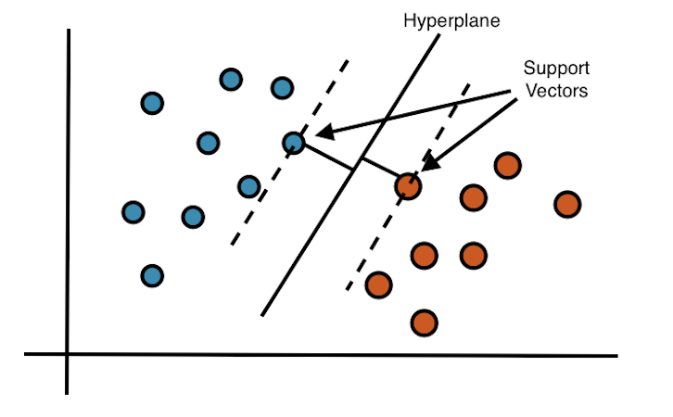
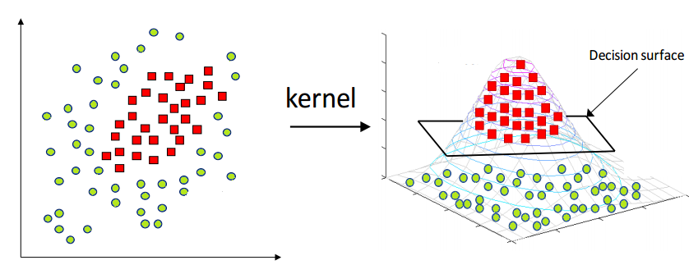
SVM VS KNN
Support Vector Machine (SVM)
Key Concepts:
Hyperplane: Decision boundary separating different classes.
Margin: Distance between the hyperplane and nearest data points.
Support Vectors: Data points closest to the hyperplane that determine its position.
Kernel Trick: Maps data into higher dimensions to solve non-linear classification problems.
Examples: Linear, Polynomial, RBF (Gaussian)
K‑Nearest Neighbors (KNN)
Concept: Classifies based on majority vote of nearest neighbors.
Distance Metrics: Euclidean, Manhattan, Minkowski.
Choosing K:
Small K → sensitive to noise.
Large K → smoother decision boundary but may underfit.
What is K-Fold Cross-Validation?
Dataset is divided into K equal folds.
Train the model on K−1 folds.
Test on the remaining fold.
Repeat until every fold has been used as the test set.
Average the results to estimate model performance.
Benefits
Better evaluation than a single train-test split.
Reduces overfitting.
Helps select the best model and hyperparameters (e.g., choosing K in KNN).
SVM VS KNN
SVM | KNN
High-dimensional data | Small datasets
Clear class boundaries | Complex decision boundaries
Faster prediction | No training phase
Good for text/image classification | Easy to understand and implement
Less affected by irrelevant features | Sensitive to feature scaling
11

Slide 16
K‑Means Clustering & DBCAN Overview
K‑Means Clustering
Centroids: Central points representing each cluster.
Inertia: Sum of squared distances between samples and their assigned centroid; measures cluster compactness.
Elbow Method: Plot inertia vs. number of clusters (K). The “elbow” point indicates optimal K.
DBSCAN Overview
Density‑based clustering algorithm.
Groups points that are closely packed together, marking outliers as noise.
Parameters:
eps: Maximum distance between two samples to be considered neighbors.
minPts: Minimum number of points required to form a dense region.
Advantage:
Finds clusters of arbitrary shape, robust to noise.
No need to specify the number of clusters.
Can detect clusters of arbitrary shapes.
Handles noise effectively.
An unsupervised learning algorithm used to group similar data into K clusters.
Each cluster is represented by a Centroid, which is the mean position of all data points in that cluster.
Real life example:
Retailers use K‑Means to group customers based on purchasing behavior
Used to group patients based on genetic markers or medical test results.
Helps in targeted marketing and personalized recommendations
12

Slide 17
PCA & Visualizing clusters
Principal Component Analysis (PCA)
A dimensionality reduction technique.
Converts high-dimensional data into fewer dimensions while retaining maximum information.
Principal Components
New axes formed by combining original features.
PC1 captures the maximum variance.
PC2 captures the second-highest variance and is orthogonal to PC1.
Use Case: Reduces dimensionality, speeds up training, improves visualization.
Visualizing Clusters in 2D
PCA reduces data to 2 principal components (PC1 & PC2).
Scatter plots display clusters clearly.
Different colours represent different clusters.
Helps evaluate clustering quality and identify overlapping clusters.
Applications:
Customer Segmentation
Market Analysis
Image Compression
Anomaly Detection
Pattern Recognition
13

Slide 18



Model evaluation & Cross-validation strategies
Model Evaluation Metrics
Precision
Measures the proportion of correctly predicted positive cases.
Formula:
High precision means fewer false positives.
Recall (Sensitivity)
Measures how many actual positive cases are correctly identified.
Formula:
​
High recall means fewer false negatives.
F1-Score
Harmonic mean of Precision and Recall.
Formula:
Useful for imbalanced datasets.
ROC-AUC
ROC Curve: Plots True Positive Rate vs False Positive Rate.
AUC (Area Under Curve):
1.0 = Perfect model
0.5 = Random prediction
Higher AUC indicates better classification performance.
Cross-Validation Strategies
Used to evaluate model performance on unseen data.
Common methods:
Train-Test Split
K-Fold Cross-Validation
Stratified K-Fold
Leave-One-Out Cross-Validation (LOOCV)
Advantages:
Reduces overfitting.
Provides a more reliable estimate of model accuracy.
Makes better use of available data.
14

Slide 19
Hyperparameter Tuning & Bias-Variance Tradeoff
Hyperparameter Tuning & Bias-Variance Tradeoff
GridSearchCV:
Tests all possible combinations of hyperparameters.
Finds the best parameter set using cross-validation.
Advantage: Highly accurate.
Disadvantage: Computationally expensive.
RandomizedSearchCV:
Tests random combinations of hyperparameters.
Faster than GridSearchCV.
Suitable for large parameter spaces.
Bias-Variance Tradeoff
Bias
Error caused by overly simple models.
Leads to Underfitting.
Variance
Error caused by overly complex models.
Leads to Overfitting.
Goal
Find the balance between bias and variance to achieve the best model performance.
Applications
Fraud Detection
Medical Diagnosis
Spam Email Classification
Credit Risk Prediction
Customer Churn Prediction
High Bias | High Variance
Underfitting | Overfitting
Low Accuracy | Poor Generalization
GridSearchCV | RandomizedSearchCV
Exhaustive Search | Random Search
Higher Accuracy | Faster Execution
More Computation | Less Computation
15

Slide 20
Feature selection
Feature Selection
Feature selection improves model performance by selecting the most relevant features and removing unnecessary ones.
1. SelectKBest
Selects the top K features based on statistical tests.
Reduces dimensionality and training time.
Common scoring methods:
Chi-Square (χ²) – for categorical data.
ANOVA F-test – for numerical data.
2. Recursive Feature Elimination (RFE)
Recursively removes the least important features.
Builds a model multiple times until the desired number of features remains.
Works well with algorithms like Linear Regression and Random Forest.
3. Correlation-Based Selection
Uses a correlation matrix to identify relationships between features.
Removes highly correlated (redundant) features.
Helps reduce multicollinearity.
Feature Engineering
Creating new features helps improve model accuracy.
Polynomial Features
Creates higher-degree features.
Example:
Original: x
Polynomial: x², x³
Interaction Features
Combines two or more features.
Example:
Age × Income
Height × Weight
Captures relationships between variables.
Feature Selection workflow:
Dataset → Feature Selection → Best Features → ML Model
16

Slide 21
Pipeline & ColumnTransformer
Sklearn Pipeline
A Pipeline chains multiple preprocessing and modeling steps into one workflow.
Pipeline Flow:
Advantages:
Simplifies workflow.
Prevents data leakage.
Makes code reusable and easier to maintain.
Automates preprocessing and model training.
ColumnTransformer
Processes different data types using different preprocessing techniques.
Example:
Workflow:
Benefits:
Handles mixed data types efficiently.
Applies different preprocessing to different columns.
Improves code readability and scalability.
Applications:
Customer Churn Prediction
House Price Prediction
Credit Risk Analysis
Medical Diagnosis
Recommendation Systems
Data Type | Transformation
Numerical | StandardScaler
Categorical | OneHotEncoder
Text | TF-IDF Vectorizer
Raw Data
↓
Data Cleaning
↓
Feature Scaling
↓
Feature Selection
↓
Machine Learning Model
↓
Prediction
Dataset
│
┌────┴────┐
│ │
Numeric Categorical
│ │
Scaling One-Hot Encoding
│ │
└────┬─────┘
↓
Combined Features
↓
Machine Learning Model
17

Slide 22
Text Preprocessing & Vectorization
Text Preprocessing
Text data must be cleaned and converted into structured form before modeling.
Tokenization:
Splitting text into smaller units (words or sentences).
Example:
“I HATE ML” → [“I”, “HATE”, “ML”]
Stopwords Removal:
Removes common words that do not add meaning.
Examples: is, the, a, and, in
Helps reduce noise in data.
Stemming:
Reduces words to their root form.
Example:
“playing”, “played” → “play”
Improves consistency in text analysis.
Bag of Words (BoW)
Converts text into numerical form based on word frequency.
Ignores grammar and word order.
Example:
“I love ML” → vector of word counts.
Limitations:
Large sparse matrices.
No semantic meaning of words.
TF-IDF (Term Frequency – Inverse Document Frequency)
Assigns importance to words based on frequency.
Reduces importance of common words.
Formula idea:
High TF × Low DF = Important word
Advantages:
Better than BoW for feature weighting.
Captures importance of rare but meaningful words
18

Slide 23
Naive Bayes & Sentiment Analysis
Naive Bayes Classifier (Text Classification)
A probabilistic machine learning algorithm based on Bayes Theorem.
Commonly used for text classification tasks.
How it works:
Calculates probability of a class given words in a document.
Assumes features are independent (naive assumption).
Types:
Multinomial Naive Bayes (best for text data)
Bernoulli Naive Bayes
Gaussian Naive Bayes
Advantages:
Fast and efficient.
Works well with high-dimensional text data.
Performs well even with small datasets.
Sentiment Analysis Basics
Process of identifying emotion or opinion in text.
Classifies text into:
Positive 😊
Negative 😡
Neutral 😐
Steps
Collect text data (reviews, tweets).
Preprocess text (tokenization, stopwords removal).
Convert text into vectors (BoW / TF-IDF).
Train classifier (Naive Bayes / ML model).
Predict sentiment.
19

Slide 24
End-to-End Machine Learning Project Workflow
End-to-End Machine Learning Project Workflow
An end-to-end Machine Learning (ML) project follows a structured pipeline from problem understanding to final deployment and reporting.
Problem Definition
Clearly define the objective of the ML project.
Identify:
Type of problem (Classification / Regression / Clustering)
Target variable
Success metrics (Accuracy, RMSE, F1-score)
Dataset Selection
Choose a relevant and high-quality dataset.
Sources:
Kaggle
UCI Machine Learning Repository
Real-world company data
Ensure:
Sufficient data size
Balanced classes (if classification)
Minimal missing values
Full ML Pipeline
Step-by-step Workflow
EDA (Exploratory Data Analysis)
Understand patterns, distributions, and correlations
Data Preprocessing
Handling missing values
Encoding categorical variables
Feature scaling
Modeling
Train ML models (e.g., Linear Regression, Random Forest, SVM)
Evaluation
Measure performance using metrics
Compare multiple models
Pipeline Flow Diagram:
Problem Definition
↓
Dataset Collection
↓
EDA (Analysis)
↓
Preprocessing
↓
Model Training
↓
Evaluation
↓
Best Model Selection
20

Slide 25
Evaluation, Visualization & Reporting
Model Evaluation
Evaluate model performance using:
Accuracy
Precision, Recall, F1-score
ROC-AUC (for classification)
RMSE / MAE (for regression)
Reporting Results with Visualizations
Common Visualizations
Confusion Matrix (classification performance)
ROC Curve (model discrimination ability)
Feature Importance Plot
Error Distribution Plot
Actual vs Predicted graph
Why Visualization is Important?
Makes results easy to understand
Helps compare multiple models
Identifies errors and patterns
Supports decision-making
Final Output
Select the best-performing model
Deploy or present results
Summarize insights and business impact
Applications
Fraud Detection Systems
House Price Prediction
Customer Churn Prediction
Medical Diagnosis Models
Recommendation Systems
22

Slide 26
References
Webesite | Link | Why it is Useful
GeeksforGeeks | https://www.geeksforgeeks.org/machine-learning/ | Simple explanations, beginner-friendly content
Wikipedia | https://en.wikipedia.org/wiki/Machine_learning | Reliable definitions and background knowledge
Analytics Vidhya | https://www.analyticsvidhya.com | Easy-to-understand ML explanations
Towards Data Science | https://towardsdatascience.com | Real-world ML examples and insights
Kaggle | https://www.kaggle.com | Best for practical examples and visuals
Scikit-learn documentation | https://scikit-learn.org | Accurate technical reference for ML models

